Slide 1
Fast Start 2018 Optimizing Resources, Scheduling, and Deployment With Decision Optimization for DSX João (John) Chaves Analytics Solutions Architect

Slide 2
Learning Objectives
By the end of this session, you should be able to …
Articulate the structure of Decision Optimization for Data Science (DODS)
Understand the different options for running DO in DSX Local
Build simple solutions using DO in DSX Local

Slide 3
Agenda
IBM Optimization Solutions
Architecture
Review DOCplex, Cloud & API
Decision Optimization Add-On to DSX Local
Hands-on exercises:
Utilizing the DOCplex Python API from Notebooks
Creating an Optimization Model & Planning scenarios with DODS
Preview Execution Service (coming soon)

Slide 4
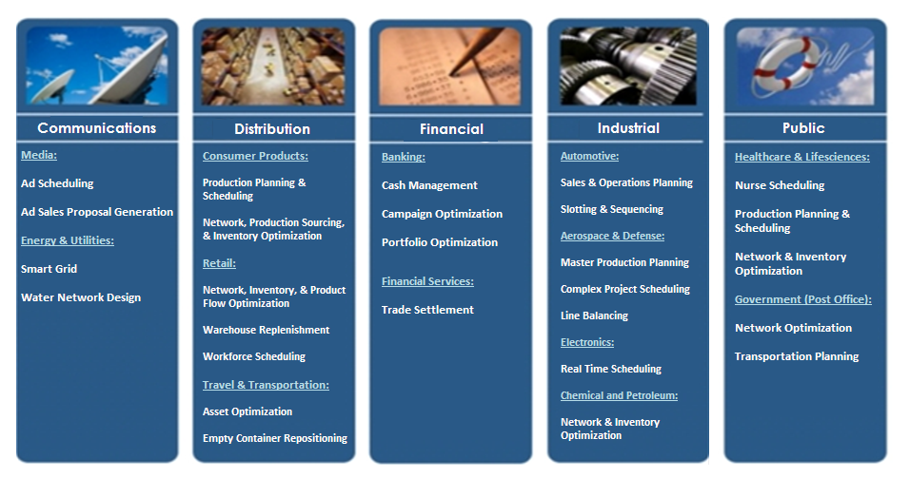
Industry Use Cases

Slide 5
Prescriptive Analytics is about…
Making the best decision possible given objective and constraints.
Manage resource efficiency, utilization and allocation
Decide, choose, plan, schedule, assign, route, source, maintain, locate, trade-off
Don’t miss the Use Case 3 Review Presentation:
Increase Operational Efficiency
When: Thursday, February 1 @ 13:45 (1:45 PM)
Where: Melia, Toledo II
CPLEX
Prescriptive Analytics
What should we do?
Optimization,
Uncertainty mgt
Competitive
Advantage
Predictive Analytics
Why did it happen? What will happen?
Predictive model,
Forecast, Simulation, Alerts
Descriptive Analytics
What has happened?
Standard/ad Hoc Reports
Query, Drill down
Business Value

Slide 6
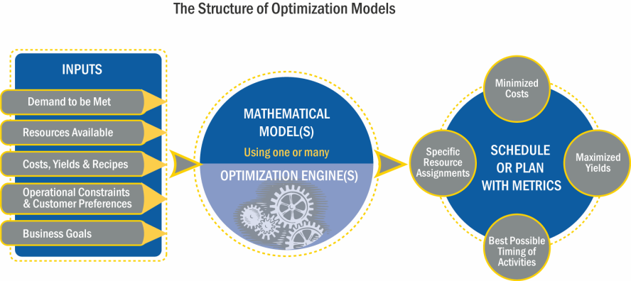
Components of an Optimization Solution

Slide 7

DISCLAIMER
THE DECISION OPTIMIZATION FOR DATA SCIENCE (DODS) ADD-ON TO DSX IS - AS OF JANUARY 29TH 2018 - STILL IN BETA, WITH RELEASE SCHEDULED FOR THE END OF Q1, 2018.
THE FEATURES PRESENTED HERE AND ON THE LAB EXERCISES MAY CHANGE UNTIL THE PRODUCT’S FINAL RELEASE.

Slide 8

DODS is an Add-on to DSX Local
Data Scientist - Browser
Data Stores (DB2, HDFS, etc…)
LDAP/AD
Spark Cluster
Customer Systems
DSX Local Cluster
NGINX
DSX UI Service
Compute Servers
Control Servers
Storage Servers
Admin Dashboards
Redis
Kubernetes Cluster
Metering Monitoring
Gluster
Zeppelin Notebook Service
Jupyter Notebook Service
Spark Service
RStudio Service
Project Service
Kubernetes Master Components
Cloudant
Storage
Canvas & Models
Analytic
libraries
DODS
Docplex
DODS

Slide 9
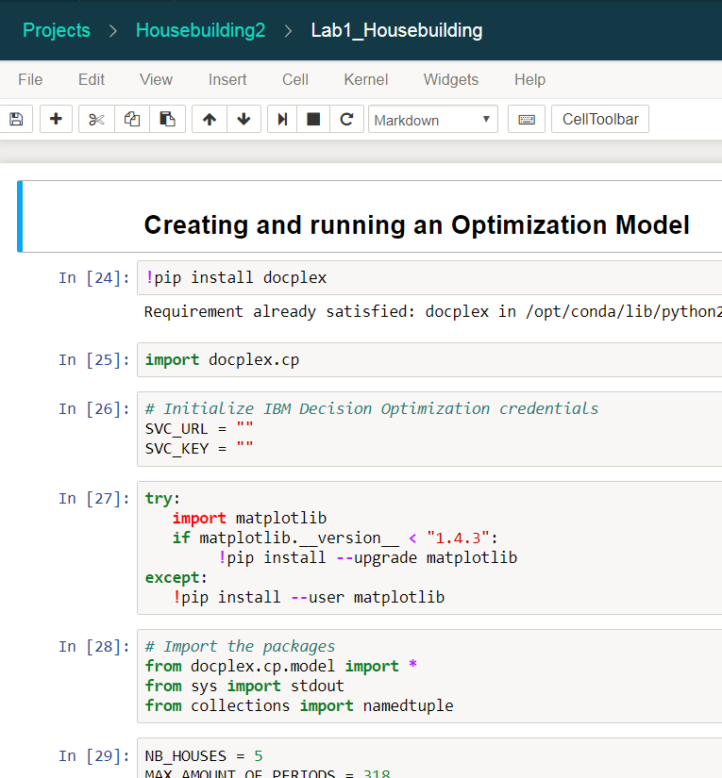
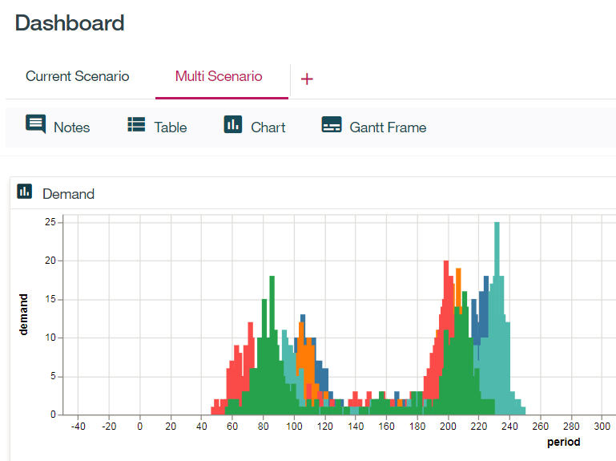
Three Ways to Run Optimization in DSX Local
DOCplex Python API on Jupyter Notebooks
Local
On Cloud
Using the DODS Add-on (BETA)
Framework API from a Notebook (require DODS) (BETA)
Using the Remote Execution service (BETA)

Slide 10




Using the DOCplex Python API on Jupyter Notebooks
Jupyter Notebook
Create the Model, Objectives and Constraints
API
Submit the job
Get the results and display the results
DOCloud Servers
(on Cloud or On Prem)

Slide 11
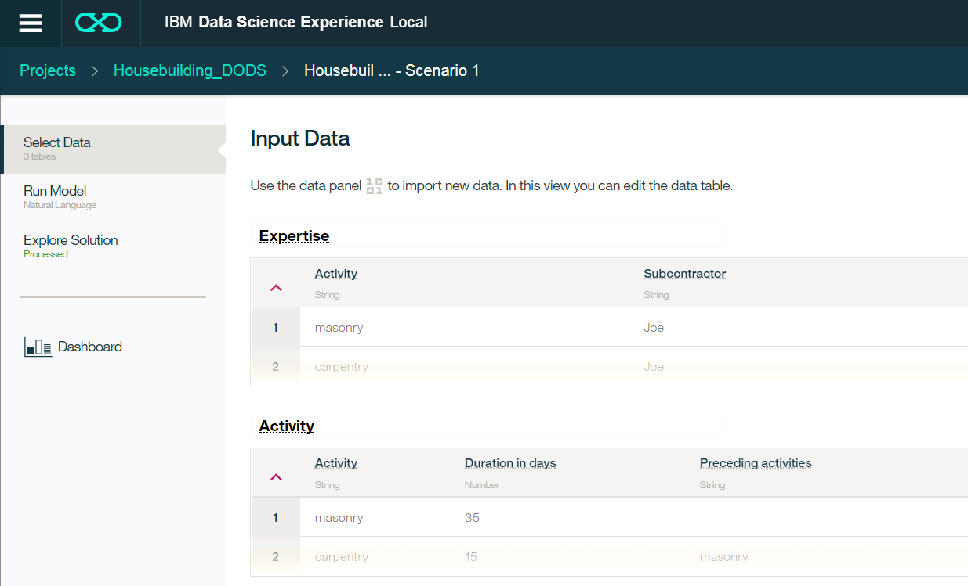
Using the DODS Add-on
Select data input & output
Manually create & import a mode or train one interactively
Basic charts and data widgets

Slide 12
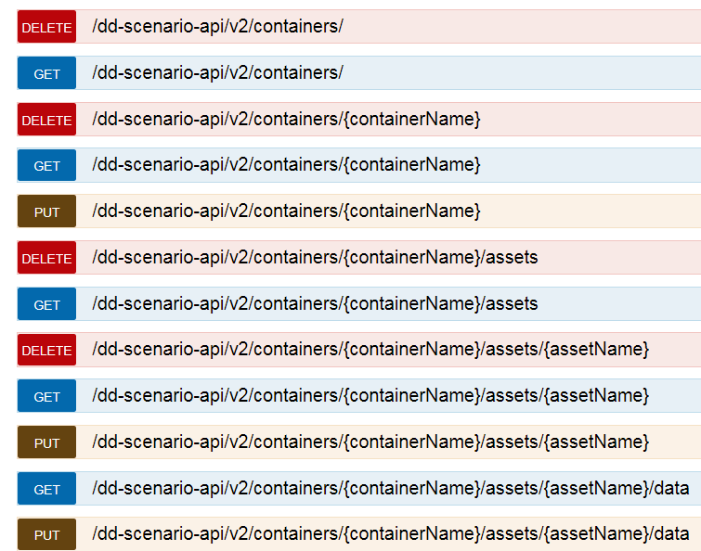
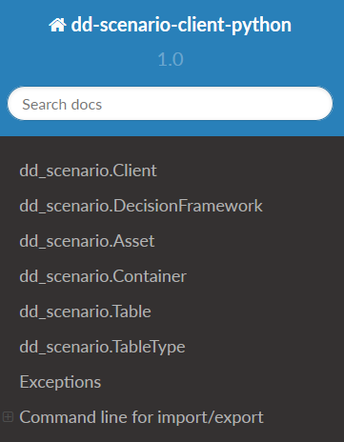
Using DODS Decision Framework API (BETA) in Jupyter Notebooks
Use and existing Scenario or create a new one
Useful for What-If analysis
Use the Python API in a Notebook or REST API

Slide 13


Using the Remote Execution Service (BETA)
Use the Decision Framework API
Community Projects → dsx-samples → DecisionOptimizationModelDeployment
Allows for publishing and executing a model.
DODS
Notebook/API
Create & Test Model
Create & Test Model
Generate URL & Token
Publish
URL
Execute
Token

Slide 14
Lab Work
https://github.com/jc900/FastStart_DDLabs
Follow instructions on the Readme
Lab 1 - Utilizing the DOCplex Python API from Notebooks
Lab 2 - Creating an Optimization Model & Planning scenarios with DODS
Lab 3 – Preview: Execution Service (BETA)

Slide 15
Where to Go to Learn More…
DSX Local - https://datascience.ibm.com/docs/content/local/welcome.html
DODS (git hub) – https://w3-connections.ibm.com/wikis/home?lang=en#!/wiki/Wf58c4c538dbf_45b4_b7a7_5003d0ceb79b/page/ZACS (navigate to Decision Optimization).

Slide 16
Thank you
John Chaves
Analytics Solutions Architect
—
john.chaves@us.ibm.com
+1-813-391-5407
ibm.com

Slide 17


Slide 18
Legal Disclaimer
© IBM Corporation 2018. All Rights Reserved.
The information contained in this publication is provided for informational purposes only. While efforts were made to verify the completeness and accuracy of the information contained in this publication, it is provided AS IS without warranty of any kind, express or implied. In addition, this information is based on IBM’s current product plans and strategy, which are subject to change by IBM without notice. IBM shall not be responsible for any damages arising out of the use of, or otherwise related to, this publication or any other materials. Nothing contained in this publication is intended to, nor shall have the effect of, creating any warranties or representations from IBM or its suppliers or licensors, or altering the terms and conditions of the applicable license agreement governing the use of IBM software.
References in this presentation to IBM products, programs, or services do not imply that they will be available in all countries in which IBM operates. Product release dates and/or capabilities referenced in this presentation may change at any time at IBM’s sole discretion based on market opportunities or other factors, and are not intended to be a commitment to future product or feature availability in any way. Nothing contained in these materials is intended to, nor shall have the effect of, stating or implying that any activities undertaken by you will result in any specific sales, revenue growth or other results.
Performance is based on measurements and projections using standard IBM benchmarks in a controlled environment. The actual throughput or performance that any user will experience will vary depending upon many factors, including considerations such as the amount of multiprogramming in the user's job stream, the I/O configuration, the storage configuration, and the workload processed. Therefore, no assurance can be given that an individual user will achieve results similar to those stated here.
All customer examples described are presented as illustrations of how those customers have used IBM products and the results they may have achieved. Actual environmental costs and performance characteristics may vary by customer.
All references to fictitious companies are used for illustration purposes only.

